Slide 1
Project #2 Final Demo: $N algorithm, 6-user dataset Group 11: Jagan Dwarampudi, Mohammad Shameer Mulla
CIS6930 Human-Centered Input Recognition Algorithms Instructor: Dr. Lisa Anthony, Spring 2023
April 18, 2023

Slide 2
Project #2 Overview
Algorithm: $N algorithm
Language: Python
Existing dataset*: mmg dataset (10 users)
New dataset*: Multistroke gestures (6 users)
Analysis: GHOST

Slide 3
Online / Live Demo

Slide 4
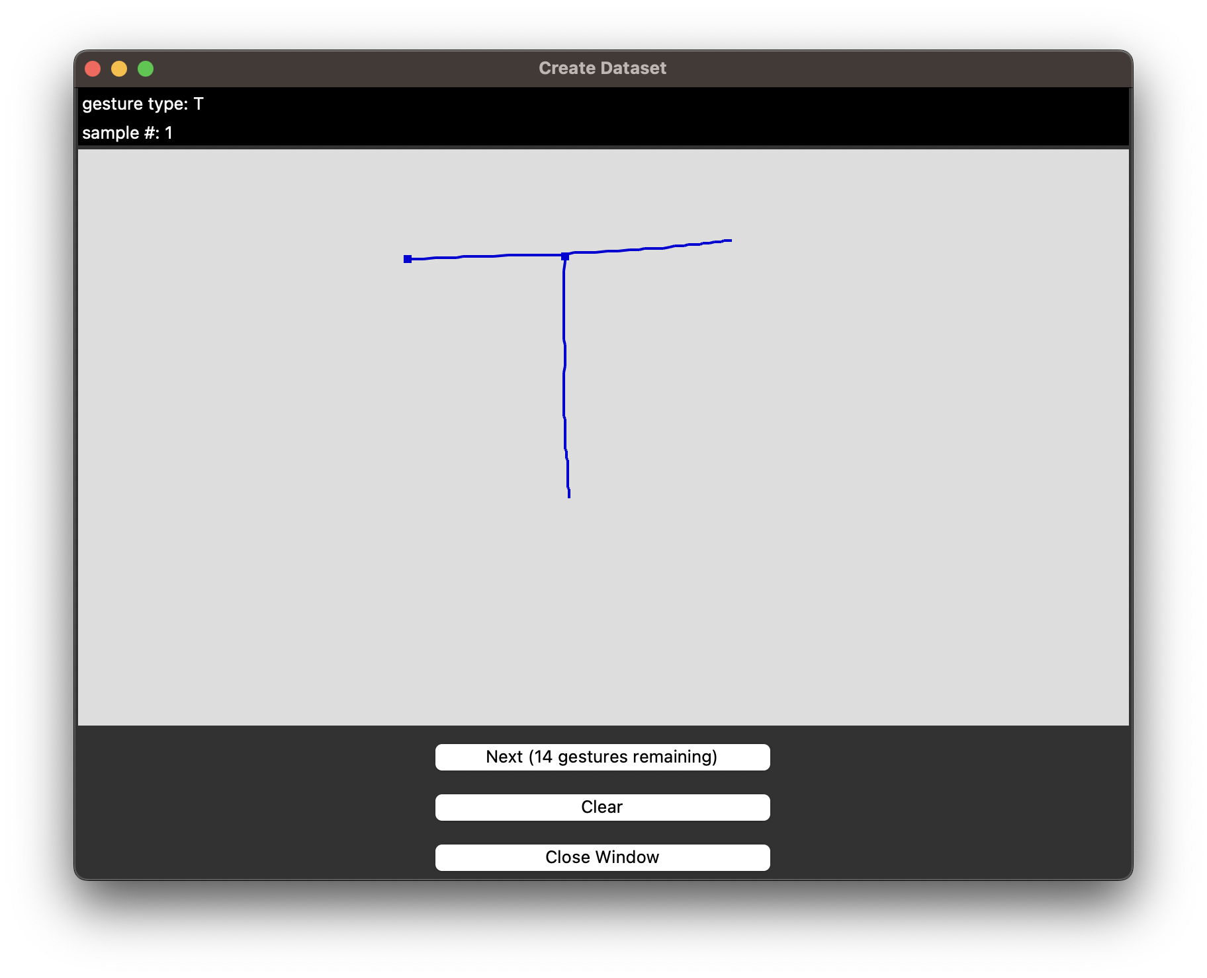
Collecting Data

Slide 5
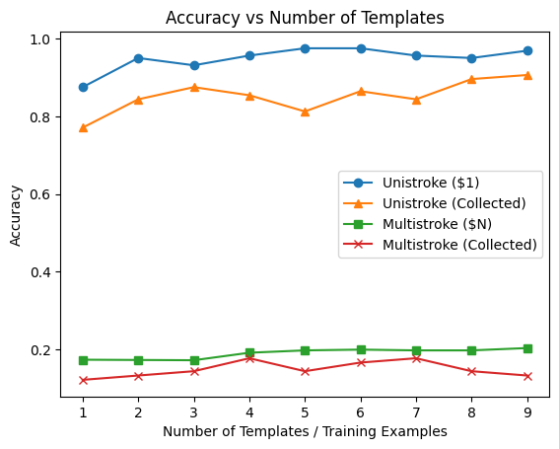
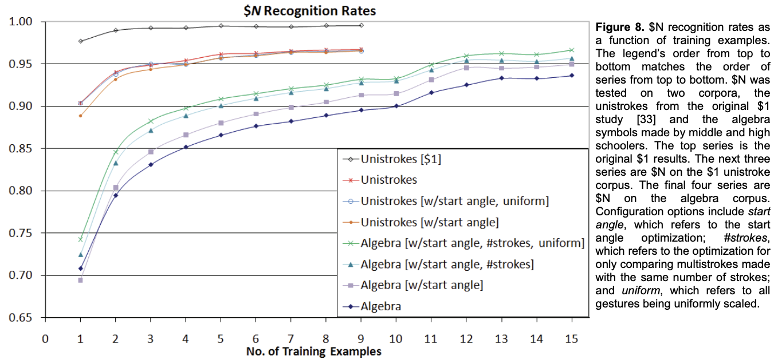
Offline Recognition Tests
Figure 8 from $N paper
Plot comparing the recognizer performance

Slide 6
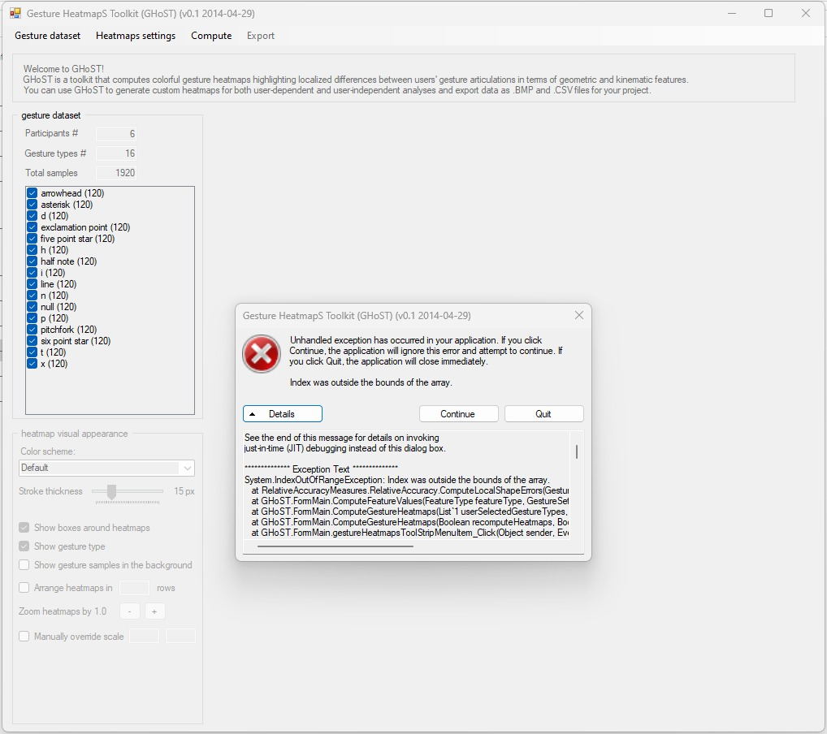
Analyses

Slide 7
Implementation and Challenges
Implementation: Project 2 GUI was an addition to Project 1. Canvas inputs were modified to take multistroke inputs. The recognizer code was implemented with reference to ndollar.js code. Recognition analysis pseudocode remains the same.
Challenges:
Support for 1D gestures returned zero division errors. It needed additional conditions.
Single point strokes like exclamation dot(.) had zero bounding box causing errors. The gesture had to be removed from analysis.
Repeating points in mmg dataset caused resampling and unit vector calculation errors. Manually corrected.
Unknown errors persist that led to low accuracies.

Slide 8
Predicted and Actual Outcome
Predicted: Implemented $N algorithm would perform similar to the one proposed in the original paper. Newly collected datasets may have lesser recognition accuracies but should match that of original datasets.
Actual: The current algorithm works considerably well with unistroke gestures although it fails with multistroke gestures due to unknown reasons. Dimension scaling errors for some gestures can be resolved but need time.

Slide 9
The End!

